Slide 1
Object Recognition -ANN/CNN

Slide 2
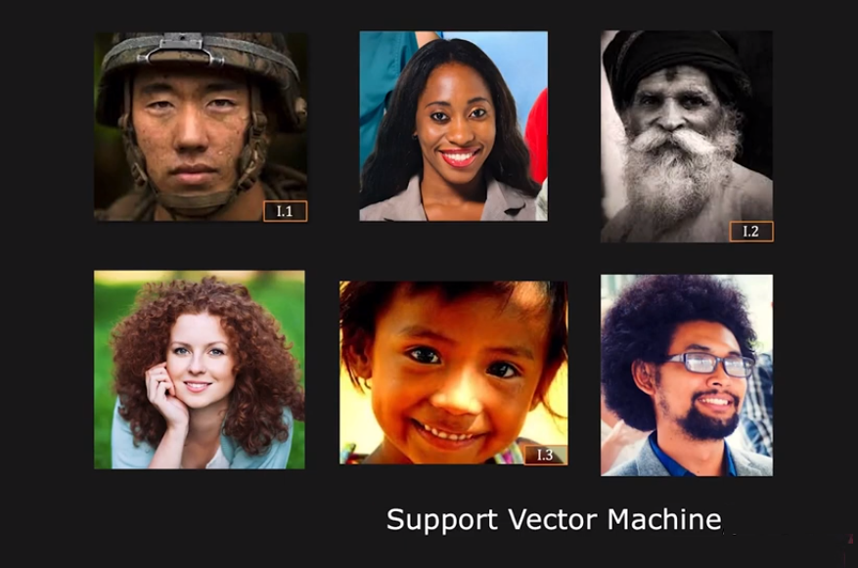
Detecting faces

Slide 3
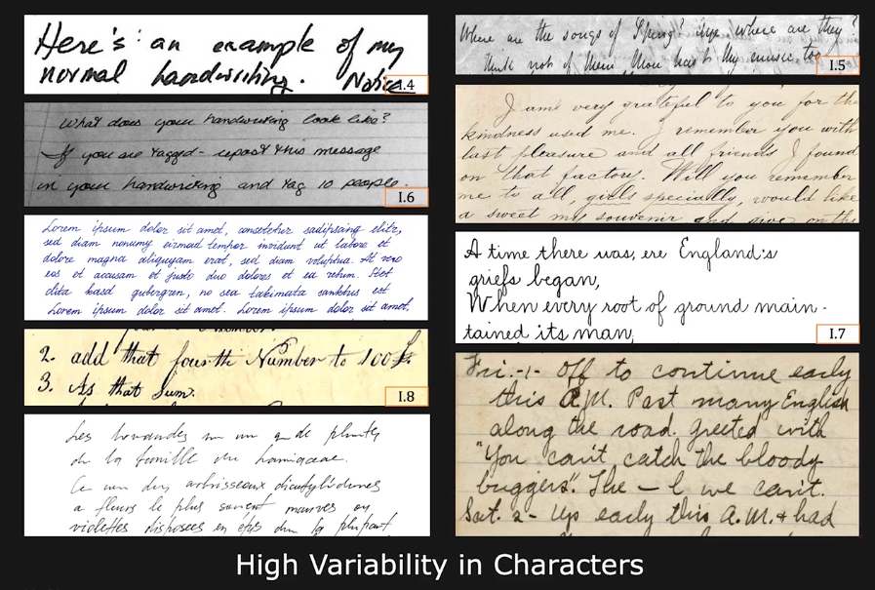
Recognizing Handwritten Text

Slide 4
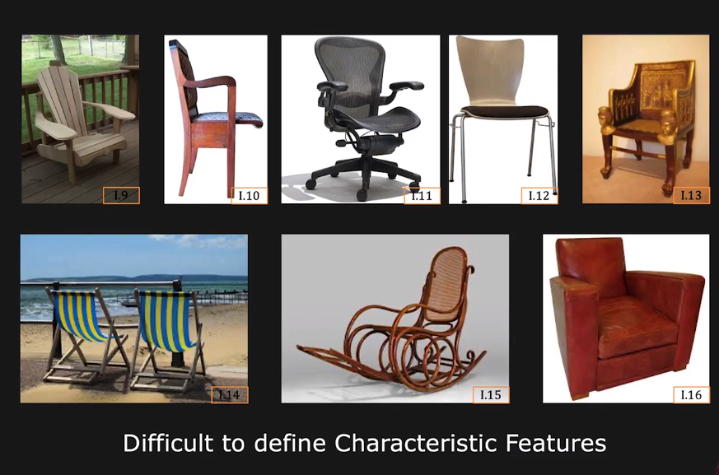
Recognizing Chairs

Slide 5
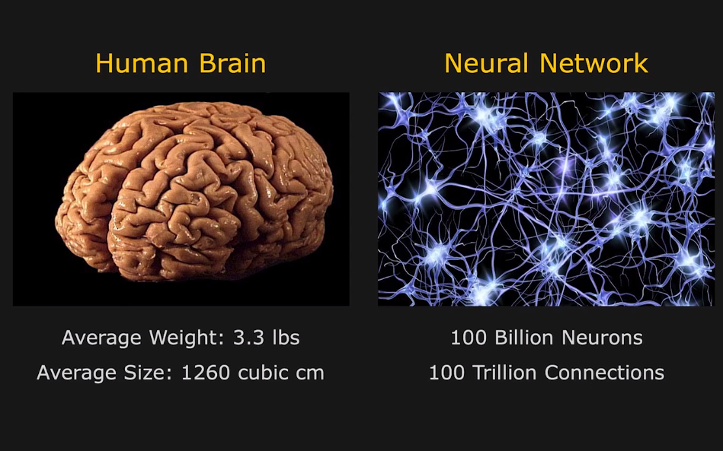
Our Neural Network

Slide 6
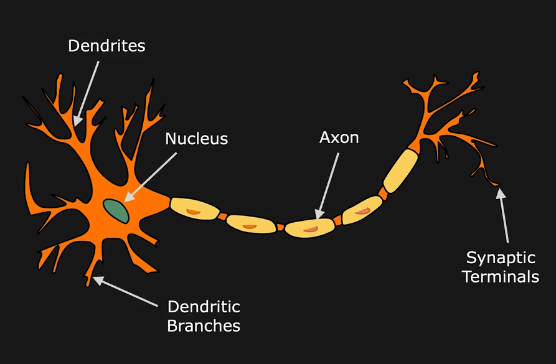
A Neuron

Slide 7
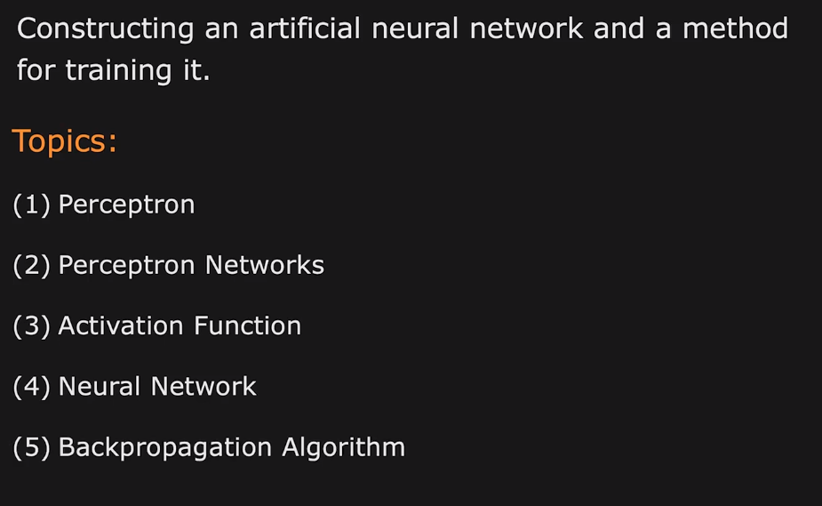
Artificial Neural Network

Slide 8
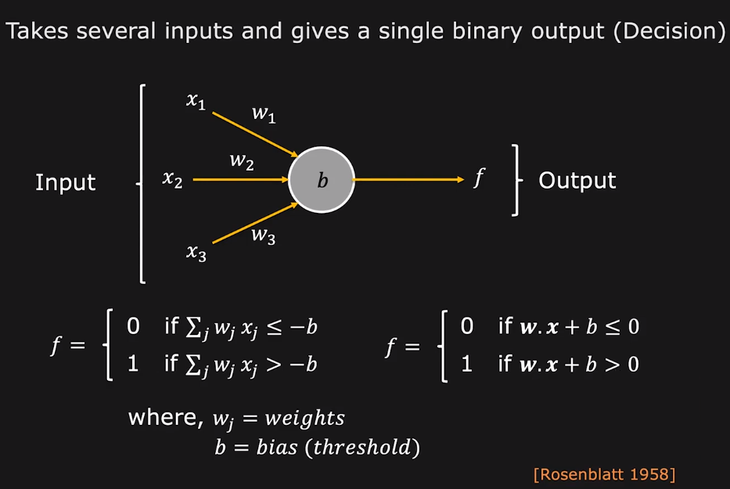
Perceptron

Slide 9
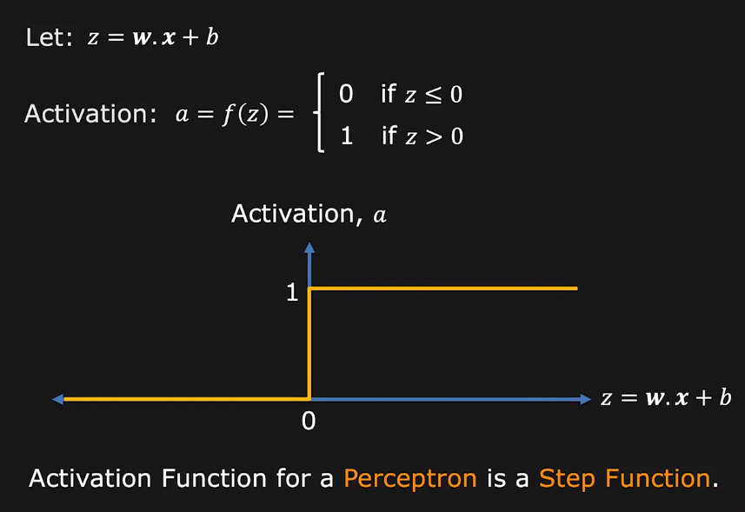
Activation function of a Perceptron

Slide 10
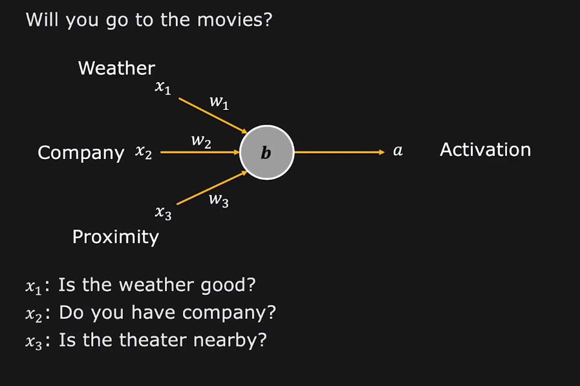
Perceptron Example

Slide 11
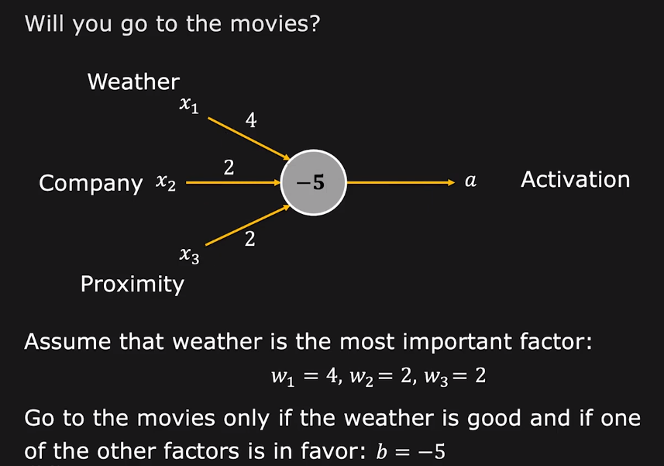
Perceptron Example

Slide 12
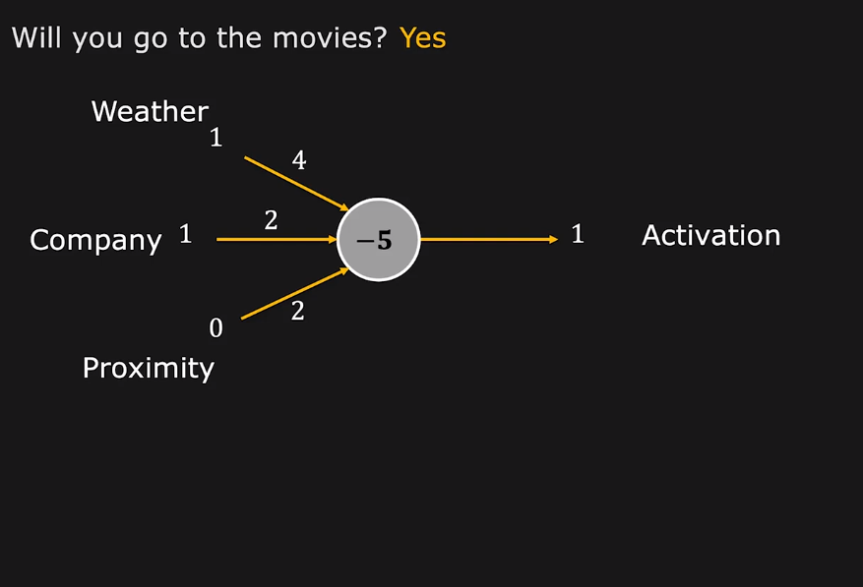
Perceptron Example

Slide 13
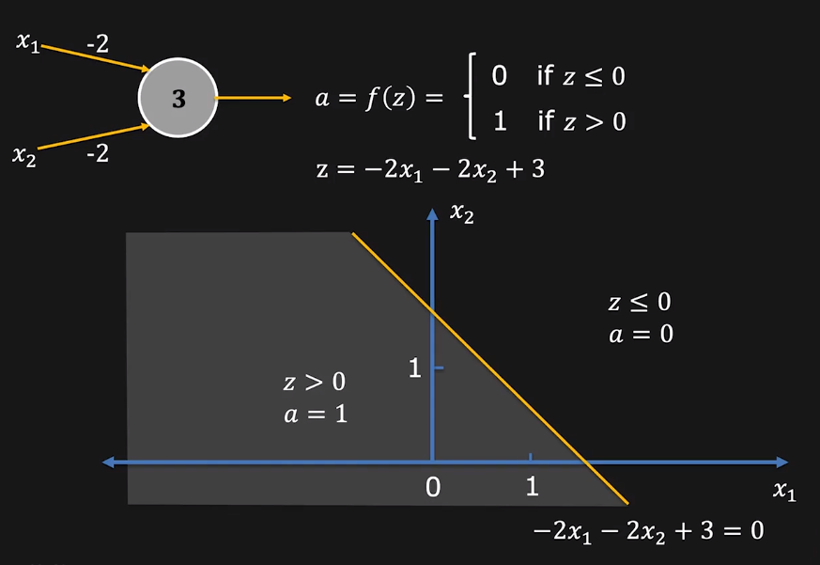
Perceptron as Linear Classifier

Slide 14
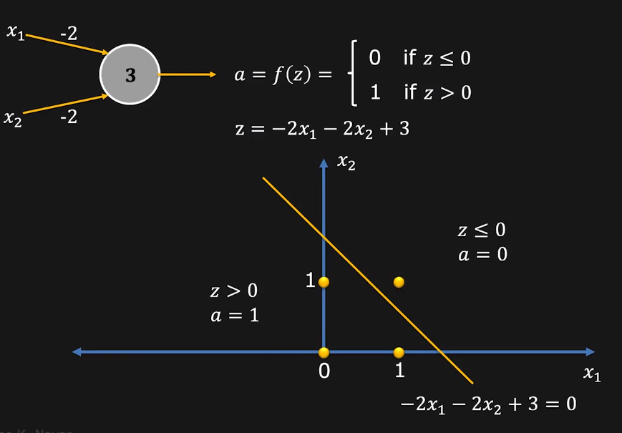
Perceptron as Linear Classifier

Slide 15
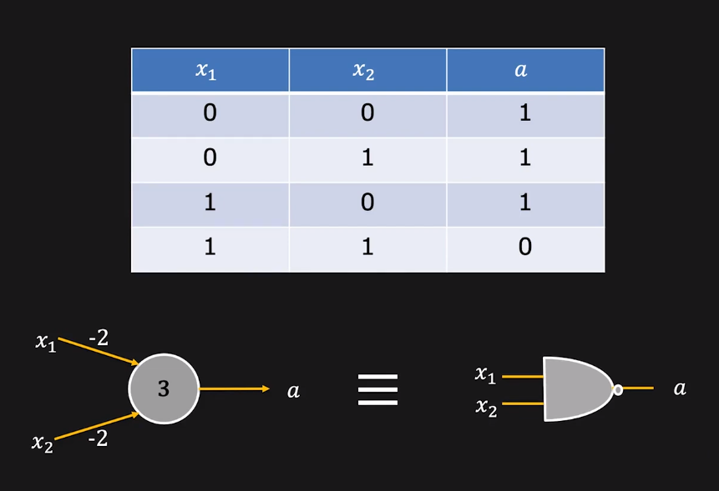
Perceptron as NAND gate

Slide 16
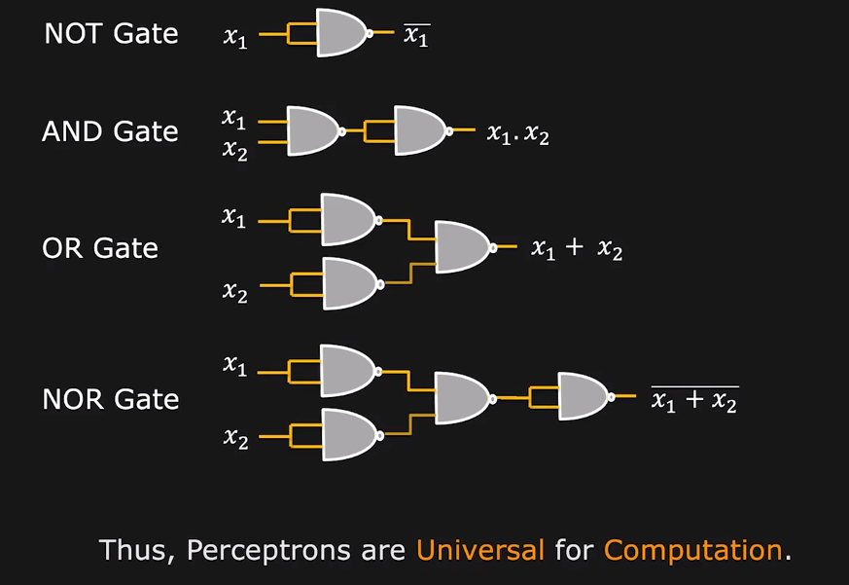
NAND Universal Logic Gate

Slide 17
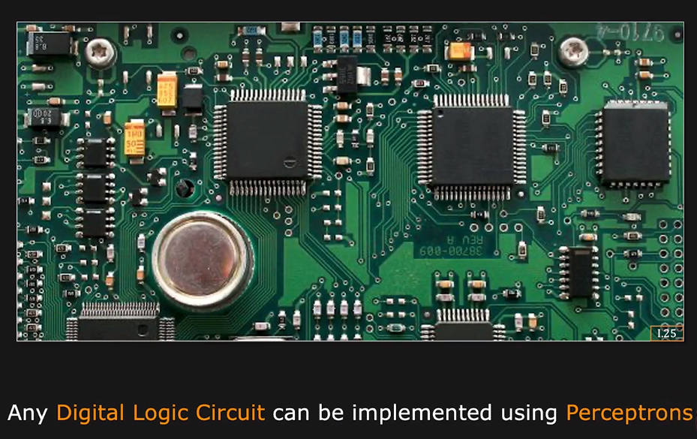
Perceptron: Computational Universality

Slide 18
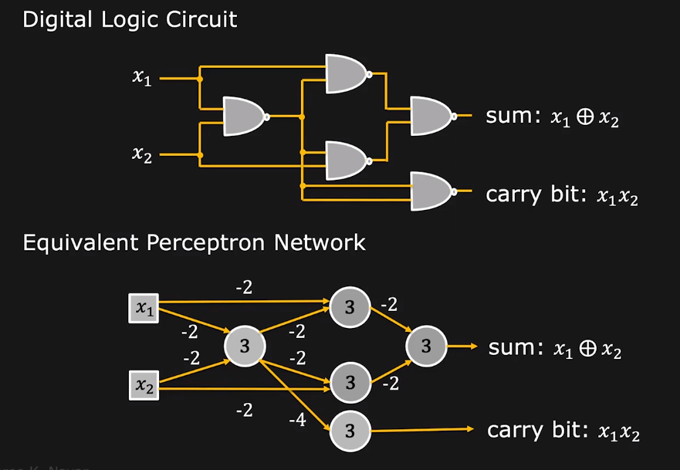
Perceptrons: 1-bit adder

Slide 19
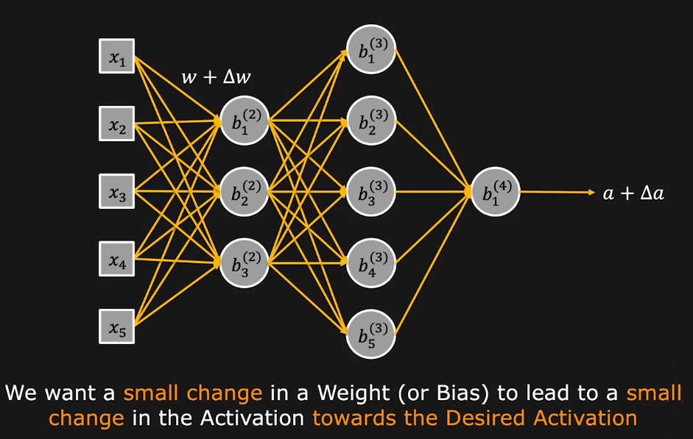
Adjusting a Perceptron Network

Slide 20
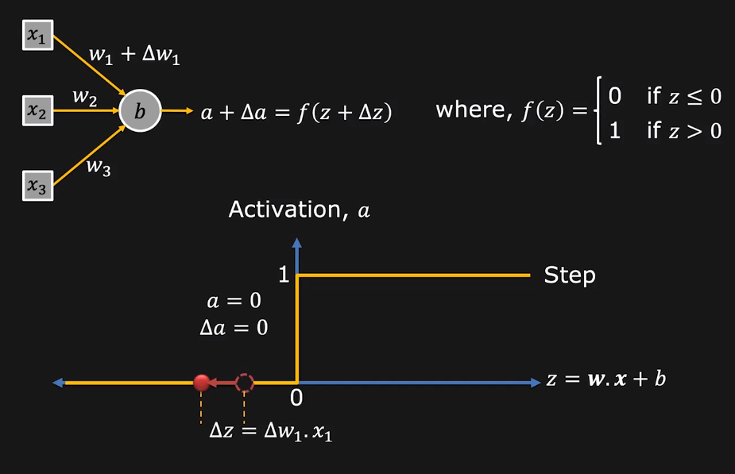
Adjusting a single Perceptron

Slide 21
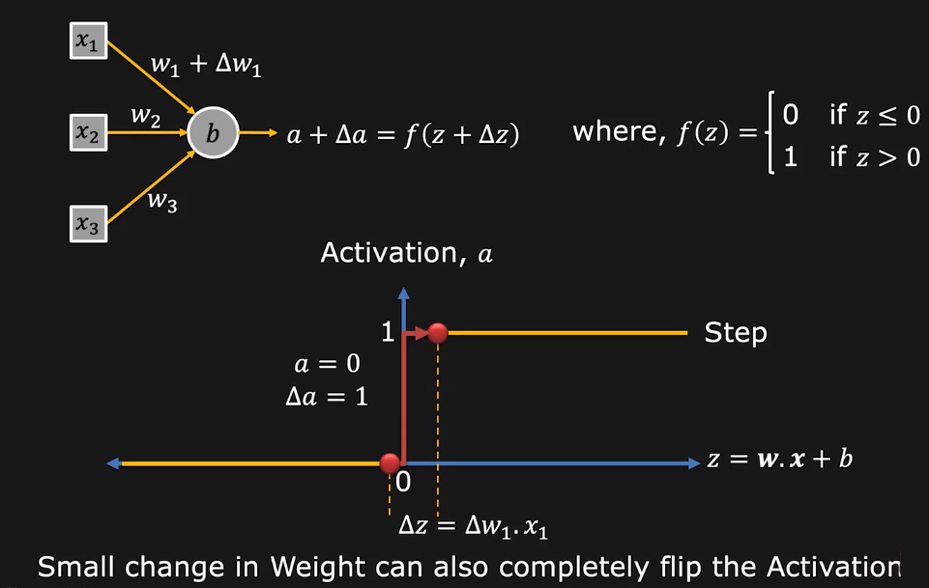
Adjusting a single Perceptron

Slide 22
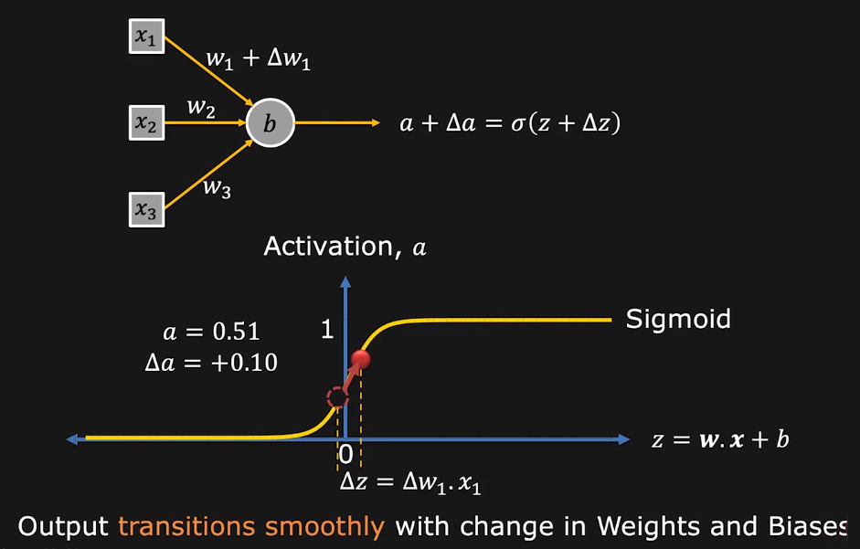
Sigmoid Neuron

Slide 23
Sigmoid Neuron

Slide 24
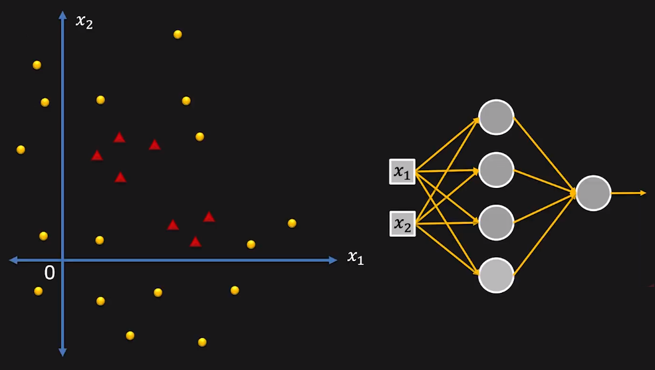
Linear Classifier for Complex Regions

Slide 25
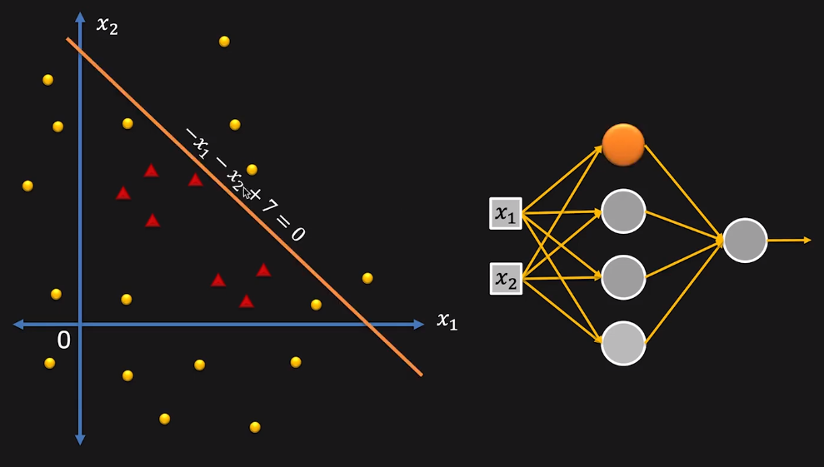
Linear Classifier for Complex Regions

Slide 26
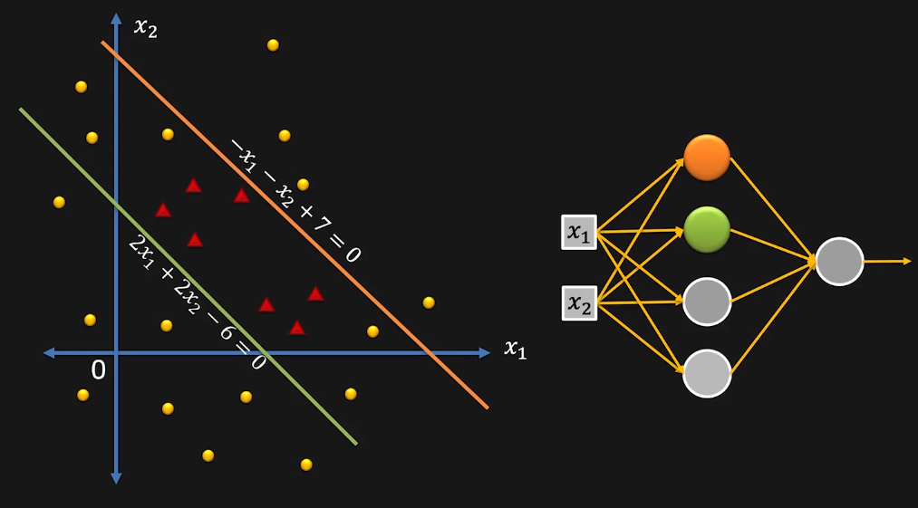
Linear Classifier for Complex Regions

Slide 27
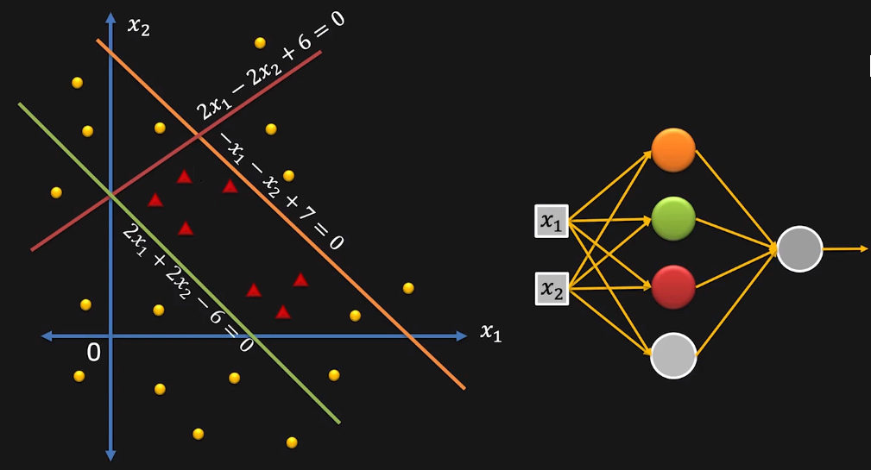
Linear Classifier for Complex Regions

Slide 28
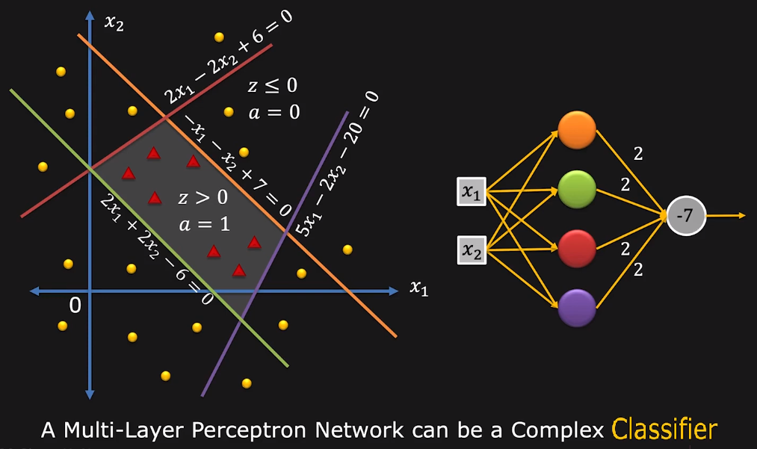
Linear Classifier for Complex Regions

Slide 29
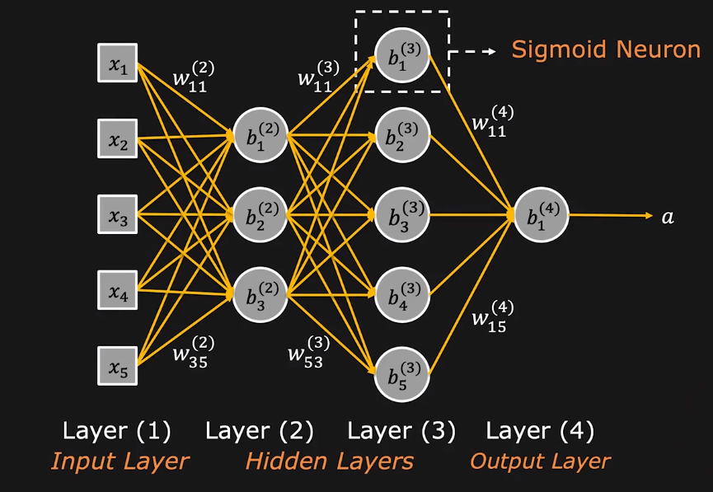
A Neural Network

Slide 30
Thanks

